Slide 1


MY FTS JOURNEY
12/08/14
BlackBerry Confidential

Slide 2
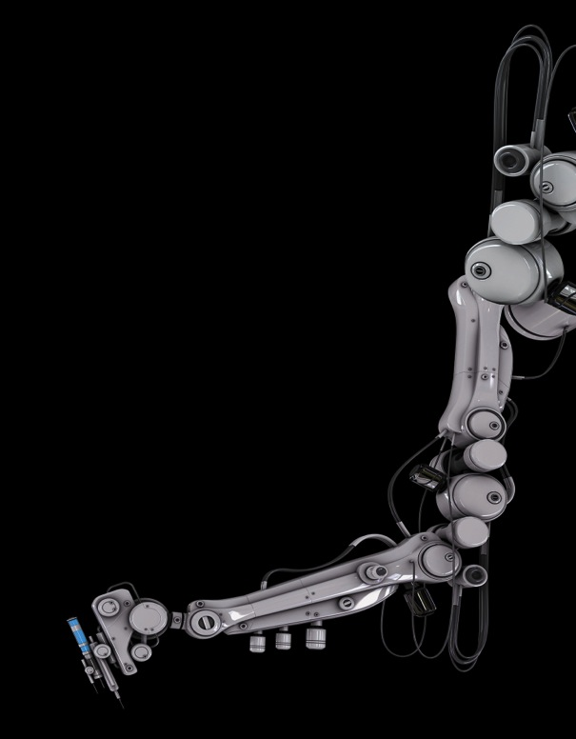
WHAT DID I DO?
Conducted user acceptance, underground and cross platform testing on various mobile handset devices both in market and out.
Developed a Carey Car System to aid testers to organise mobility testing and supplement potential cost reductions.
Issue Investigation on gating issues
Communicating with developers to provide additional information and logs about the issue.
Developed a small script that extracted failed issues during automation and presented them to testers in a clean format.

Slide 3

Skills and Technologies
Python
CSS
HTML
Bootstrap 3
Software Testing
PHP
MYSQL
Version Control Systems
Git/Github
jQuery
JavaScript

Slide 4

What I Learned?
Working in a cooperate environment
Applying different skills and technologies learned in university to a professional environment is a big change.
Communicating with team members in office and also from different countries.
Insight and opinions of professionals in industry
Technical Skills

Slide 5
MY TIME AT BLACKBERRY HAS EXCITED ME FOR A BRIGHT FUTURE.

Slide 6
THANK YOU EVERYONE ☺

